Slide 1







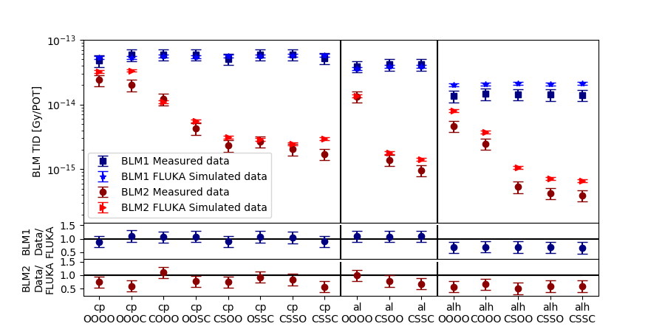
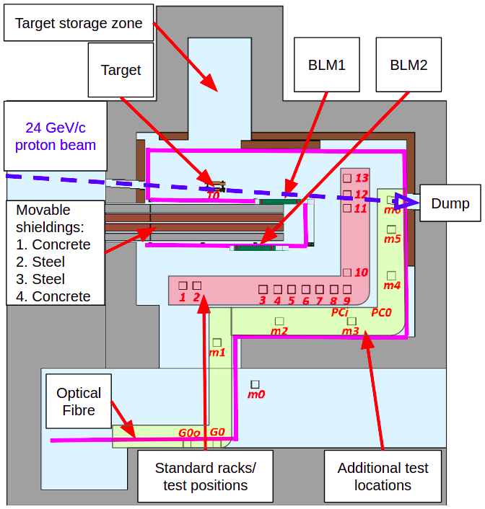
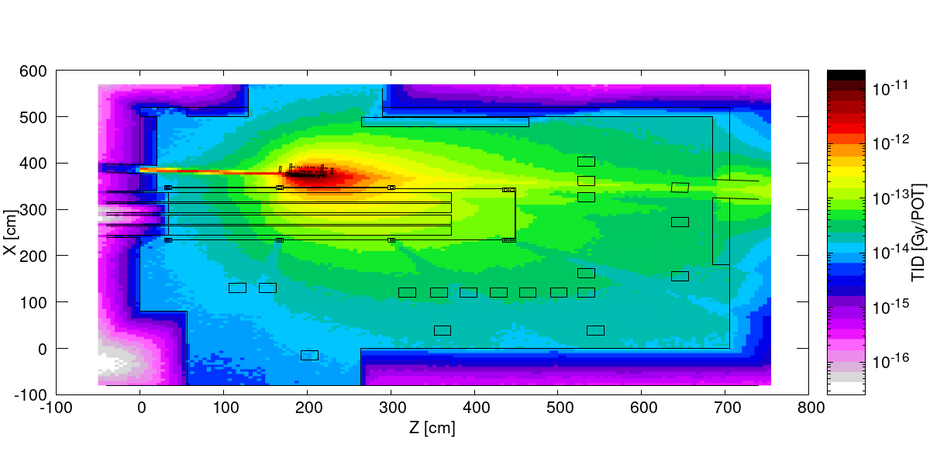
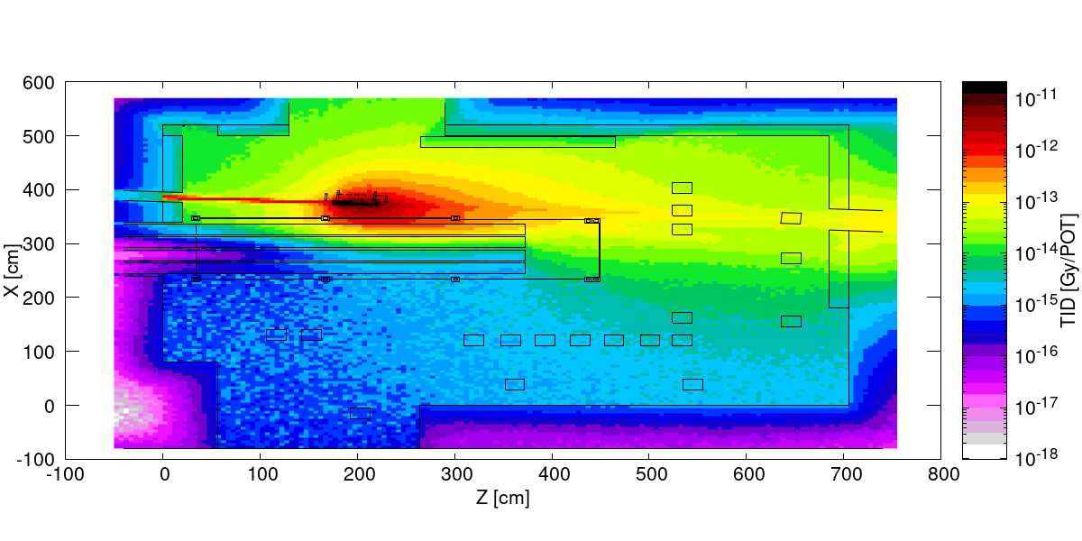
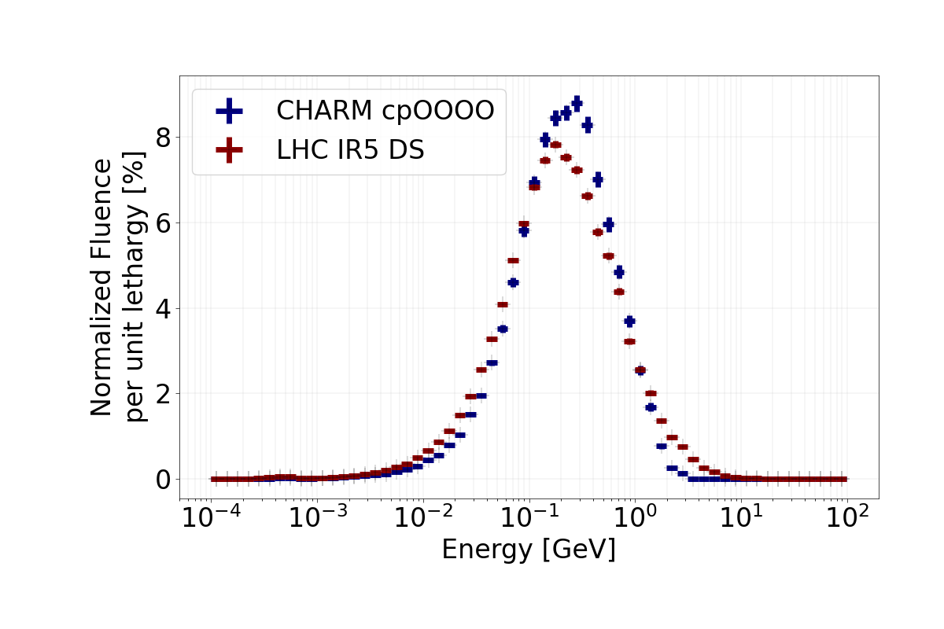
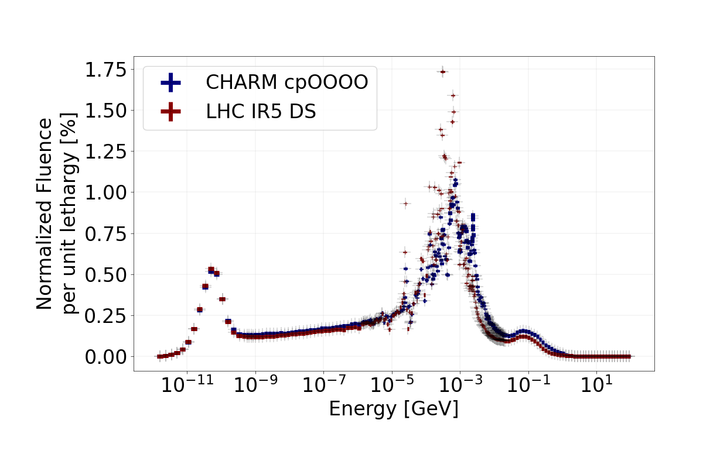
Daniel Prelipcean^{1,2} (daniel.prelipcean@cern.ch), Giuseppe Lerner¹, Rubén García Alía¹, Kacper Bilko¹, Angelo Infantino¹, Diego di Francesca¹, Daniel Ricci¹, Matteo Brucoli¹, Salvatore Danzeca¹
¹CERN (CH-1211 Geneva, Switzerland), ²Technical University of Munich (DE-80333 München, Germany)
1. The CHARM Facility at CERN
3. Benchmark Results (Selection)
A benchmark for radiation monitors employed at CERN for Radiation to Electronics (R2E) applications is performed at the Cern High energy AcceleRator Mixed field (CHARM) radiation facility [1]. Their measured values during beam operation are compared to those simulated by the FLUKA Monte Carlo code [2,3].
We compare measured data and FLUKA simulated values for the following quantities and radiation monitors:
Total Ionizing Dose (TID) recorded by Beam Loss Monitors (BLMs) [4].
High Energy Hadron (HEH) and Thermal Neutron (THN) fluences, as well as their ratio (R-factor) recorded by RadMONs [5].
Additional benchmarks are available in the full paper, namely for TID recorded by RadMONs and an Optical Fibre Sensor [6].
The values are normalized to the number of primary Protons On Target (POT). Typical POT figures at CHARM are of approx. 5x10¹¹ protons/spill and 1.5X10¹⁶ protons/week.
CHARM - Key Information:
24 GeV proton beam from CERN PS impinging on a metal target.
Irradiation Room: 7 x 5 m, 13+ test positions.
Mixed-field of p, n, K, π, μ, 𝜸, e⁻, e⁺ from GeV to thermal energies.
CHARM Advantages:
Different radiation spectrum and intensity at several locations, depending on shielding configuration/target. Rule of thumb:
Target configuration (cp,al,alh) ➜ secondary field intensity.
Shielding configuration (OOOO,CSSC) ➜ secondary field spectra.
Smaller geometry (compared to the LHC), allowing for faster simulations for detector response in similar radiation environments.
(a) cpOOOO configuration
(copper target, no shielding)
Fig. 4: TID results as recorded by the two BLMs at CHARM, for all the employed configurations. BLM1 is closer to the target, in front of the shieldings, while BLM2 is further away from the target and behind the shieldings.
Table 1: Fluence results as recorded by the the RadMONs at CHARM, for the cpOOOO configuration. Note that RadMONs were not employed at all test locations, but their value can be nevertheless simulated.
 | HEH |  |  | THNEUTRON |  |  | RFACTOR
LOCATION | Measured [cm-2/POT] | Simulated [cm-2/POT] | Measured/ Simulated | Measured [cm-2/POT] | Simulated [cm-2/POT] | Measured/ Simulated | Measured [cm-2/POT] | Simulated [cm-2/POT] | Measured/ Simulated
R1 | 1.85E-05 | 1.58E-05 | 1.17 | 5.48E-05 | 1.20E-04 | 0.46 | 2.44 | 5.91 | 0.41
R4 | 4.28E-05 | 5.13E-05 | 0.83 | 3.90E-05 | 1.26E-04 | 0.31 | 0.91 | 3.29 | 0.28
R5 | 3.49E-05 | 4.40E-05 | 0.79 | 4.60E-05 | 1.27E-04 | 0.36 | 1.32 | 3.78 | 0.35
R7 | 4.32E-05 | 4.72E-05 | 0.92 | 4.43E-05 | 1.26E-04 | 0.35 | 1.03 | 3.37 | 0.31
R9 | 2.96E-05 | 4.35E-05 | 0.68 | 5.86E-05 | 1.24E-04 | 0.47 | 1.98 | 3.54 | 0.56
R10 | 3.28E-05 | 5.18E-05 | 0.63 | 5.74E-05 | 1.23E-04 | 0.47 | 1.75 | 2.84 | 0.62
R13 | 6.66E-05 | 8.32E-05 | 0.80 | 5.98E-05 | 1.16E-04 | 0.51 | 0.90 | 1.55 | 0.58
G16 | 3.39E-05 | 3.29E-05 | 1.03 | 1.32E-04 | 1.32E-04 | 1.00 | 3.89 | 5.73 | 0.68
AVG. |  |  | 0.86±0.18 |  |  | 0.49±0.22 |  |  | 0.47±0.15
(a) cpCSSC configuration
(copper target, full shielding)
Fig. 1: CHARM Facility top view, showcasing the location of the target, shieldings and radiation dosimeters.
Fig. 2: Top view of the CHARM TID 2D map at target height, as simulated by FLUKA.
2. Comparison between CHARM and LHC
4. Conclusions
The radiation environment of the LHC is well reproduced at CHARM, as previously confirmed in Ref. [1] for the case of the LHC shielded alcoves hosting electronics, with the main difference of very high-energy (>10 GeV) particles at LHC. This is further confirmed by the figures below, that compare proton and neutron energy normalized spectra in the BLMs at the LHC (installed on the accelerator in the tunnel) and at CHARM, allowing to reach similar conclusions.
Test measurements have been carried out at the CHARM facility, which provides mixed radiation fields with different radiation compositions and energy spectra depending on the target material and shieldings.
We quantified the level of agreement for the comparison between measured data and simulations for three types of detectors that are generally used for R2E purposes.
The BLM results exhibit a good level of agreement, always within 40%, and often much better for individual configurations: the average ratio of the measured values over FLUKA simulated ones for all configurations is of 0.92 ± 0.18 (standard deviation) for the highly irradiated BLM1, 0.73 ± 0.17 (i.e. 27% simulation overestimation) for the more shielded BLM2.
The RadMON fluence detectors achieved a satisfactory agreement of measured to simulated values for HEH fluence of 0.78 ± 0.16 (i.e. overestimation by 20%), whereas for thermal-energy neutrons the ratio decreases to 0.49 ± 0.22 (i.e. overestimation by a factor of 2).
References
Fig. 3: Comparison of the particle spectrum scored in the active volume of the BLMs between CHARM and LHC interaction point (IP5) dispersion supressor (DS) for protons (left) and neutrons (right), in lethargy format.
References
J. Mekki et al., »CHARM: A Mixed Field Facility at CERN for Radiation Tests in Ground, Atmospheric, Space and Accelerator Representative Environments«, in: IEEE Trans. Nucl. Sci. 63.4 (2016), pp. 2106–2114.
https://fluka.cern
G. Battistoni et al., »Overview of the FLUKA code«, in: Annals of Nuclear Energy 82 (2015), pp. 10–18.
E. B. Holzer et al., »Beam loss monitoring system for the LHC«, in: IEEE Nuclear Science Symposium 2 (November 2005), pp. 1052–1056.
G. Spiezia et al., »The LHC Radiation Monitoring System - RadMon«, in: Pro. 10th International Conference on Large Scale Applications and Radiation Hardness of Semiconductor Detectors RD11 (2011).
D. Di Francesca et al., »Dosimetry Mapping of Mixed-Field Radiation Environment Through Combined Distributed Optical Fiber Sensing and FLUKA Simulation«, in: IEEE Transactions on Nuclear Science 66.1 (2019), pp. 299–305.

